Slide 1
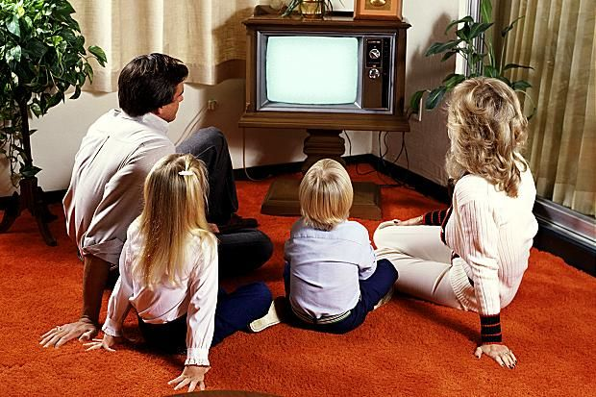

TV or not TV
Cory, Sagar, Ryan, Akhil & Vincent

Slide 2

Cutting The Cord
“Cord- Cutting”, the pattern of viewers cancelling their subscriptions to traditional cable companies in favor of multichannel subscription services
Like-Minded “cord cutters” flock to reddit to share their experiences.
We intend to figure out the tendencies of cord-cutters: how they compare streaming services, what their concerns are, their favorite shows and complaints with their services
r/cordcutters

Slide 3





Data Source and Pre-processing
Data Extraction
Data Pre-Processing
Using the Reddit API and pushshift.io (Big Query), we extracted the comments from cordcutter subreddit for the last 4 months.
Websites
Parentheses, commas, asterisks
Short comments (less than 10 words)
Various forms of the service names to a common name
Words like “shouldn’t”, “weren’t” to “should not”, “were not”
28,830 cleaned comments.

Slide 4

Finding Relevant Entities
PsVue
Roku
Youtube TV
Sling
PhiloTv
Hulu
DirectvNow
Netflix
Fubo Tv
VerizonFios
Using the spacy package
Notes:
Interpretation: There are some niche channels, cable companies, and services
Examples: AMC, Charter, Cox, WOW!, fire stick

Slide 5
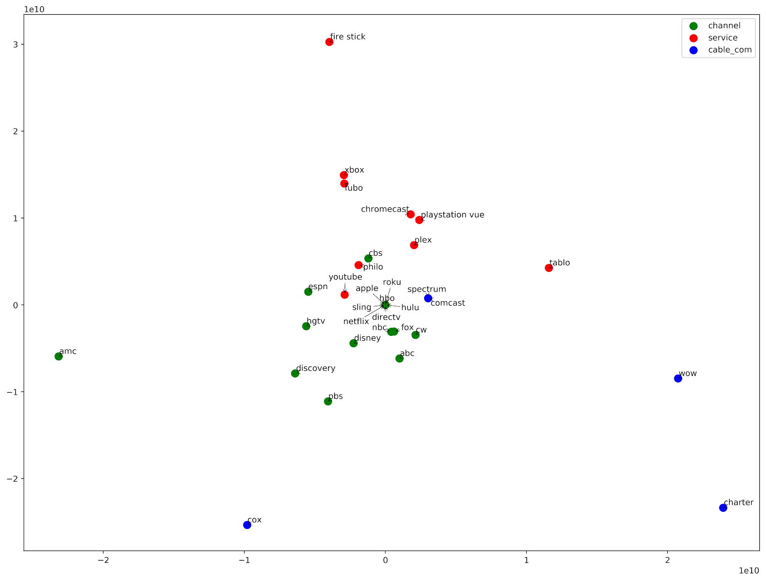
Comparing the Channels and Services
Using the lift between the entities
Notes:
Interpretation: There are some niche channels, cable companies, and services
Examples: AMC, Charter, Cox, WOW!, fire stick

Slide 6
MDS Plotting of the Entities
Using the lift between the entities
Notes:
Interpretation: There are some niche channels, cable companies, and services
Examples: AMC, Charter, Cox, WOW!, fire stick

Slide 7

Comparing the Channels and Services
After removing the cable companies, we can see which channels are associated with which services
Many of the channels are far away from the services, meaning that people are associating the channel only with the popular services (Hulu, YouTube, Sling)
Netflix is not on this list
Interesting observation: Disney has managed to pull ABC and FOX away from the channel cluster
Two factors play into this: Disney’s acquisition of FOX and the upcoming streaming service

Slide 8
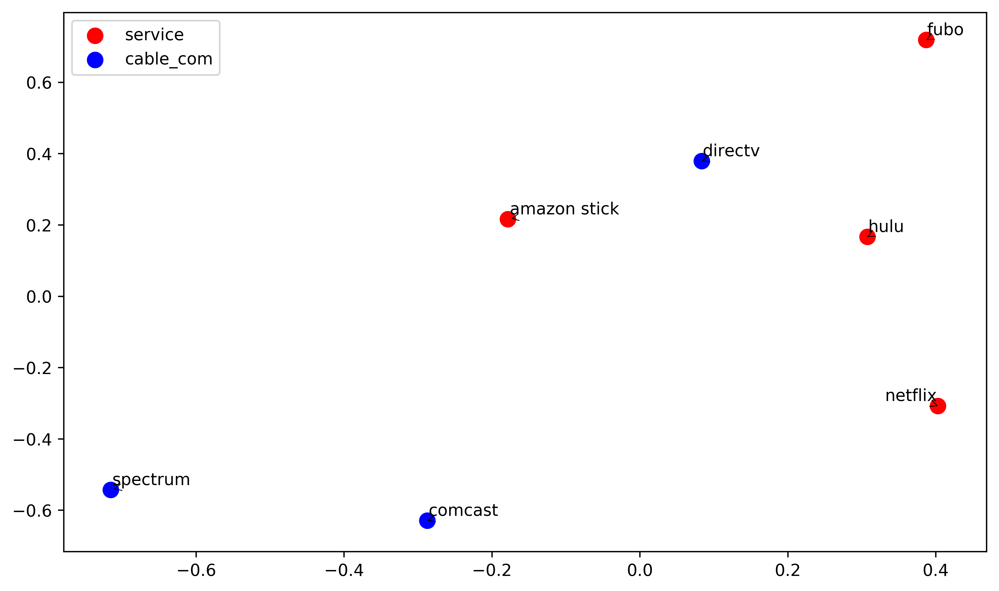
Zooming in on Popular Choices
A closer look at companies with high mentions
Notes:
The picture needs to be updated and wordsmithing needs to be done
Interpretation: Spectrum and Comcast need to worry about each other; DirecTV is pretty safe from everyone else except Fubo. Netflix and Hulu are both far away from the companies and each other, which may be surprising

Slide 9
Topic Modeling
After gauging the crowd’s perceptions of how the services and companies compared, we wanted to find out what topics were of the most concern to customers
Topic | Words within Topic
User Experience | Update, Interface, Guide, Provider, Support, Disconnect
Net Neutrality | Neutrality, Throttling, Jefferson (Thomas Jefferson), Speed, Internet
Sports Packages | Soccer, Football, Sport, Monthly, Watch
Traditional Cable Experience | Antenna, Comcast, Tuner, Broadband

Slide 10
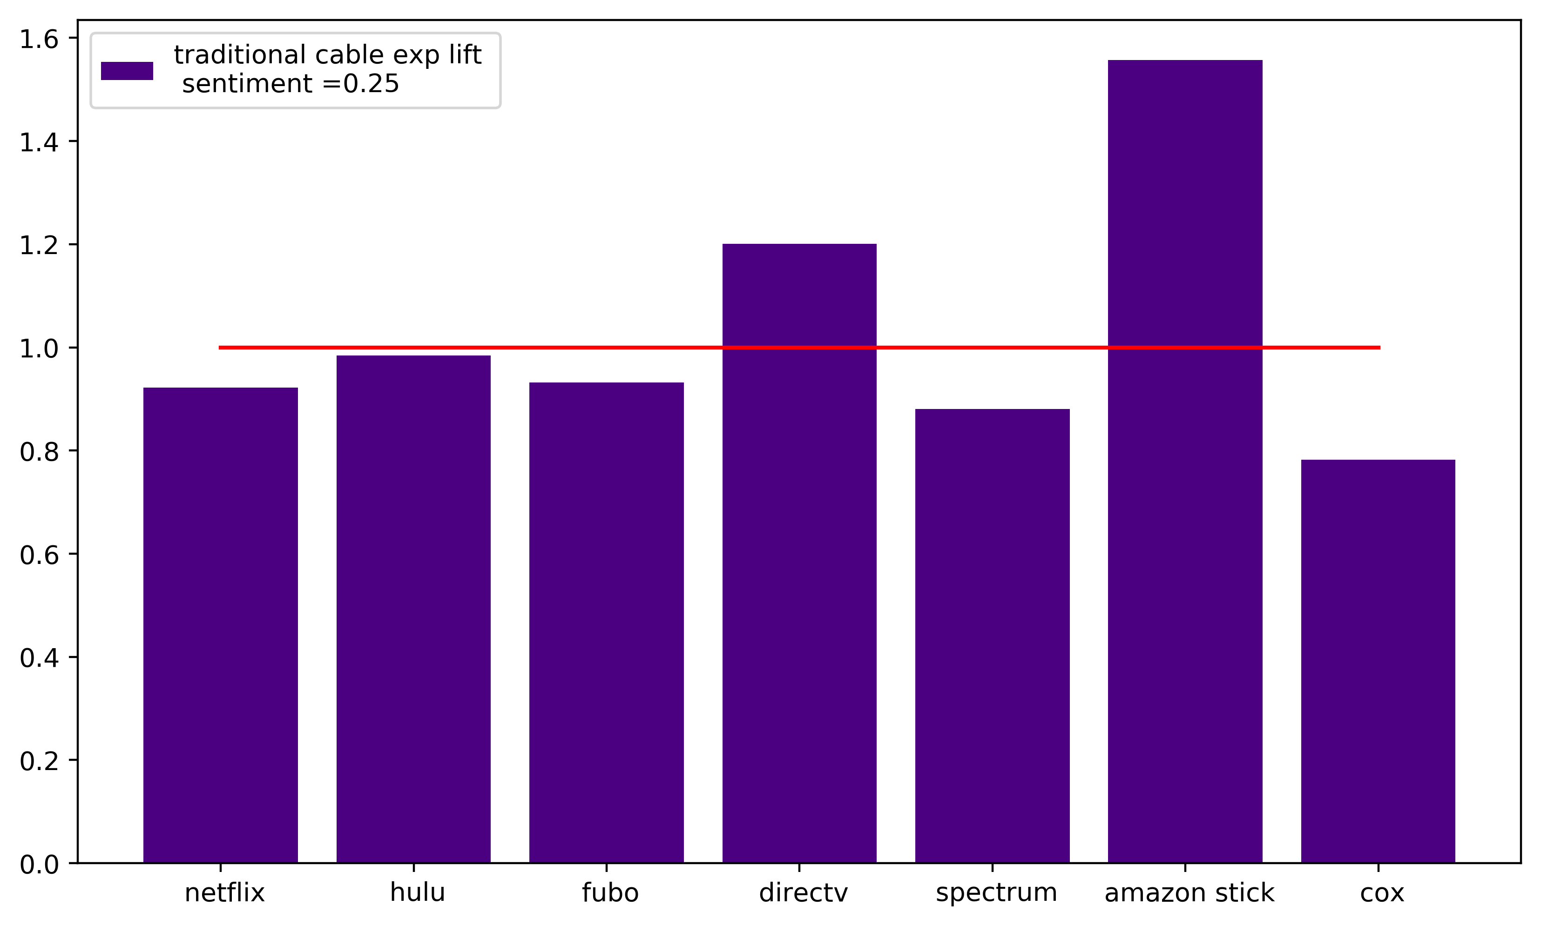
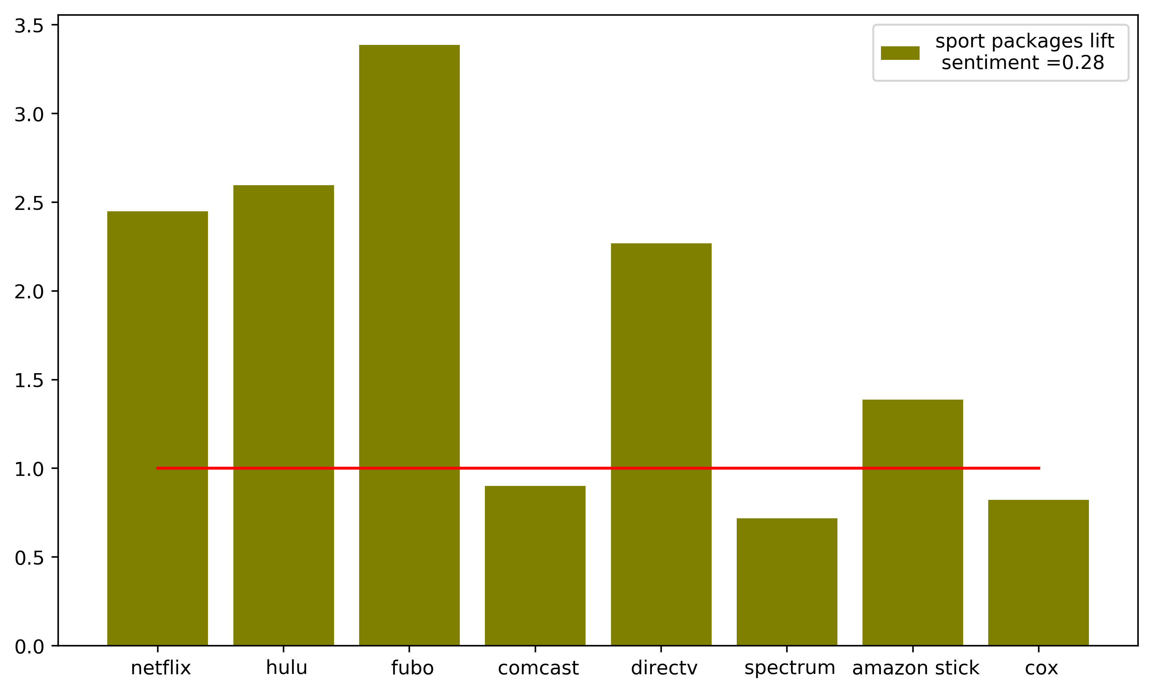
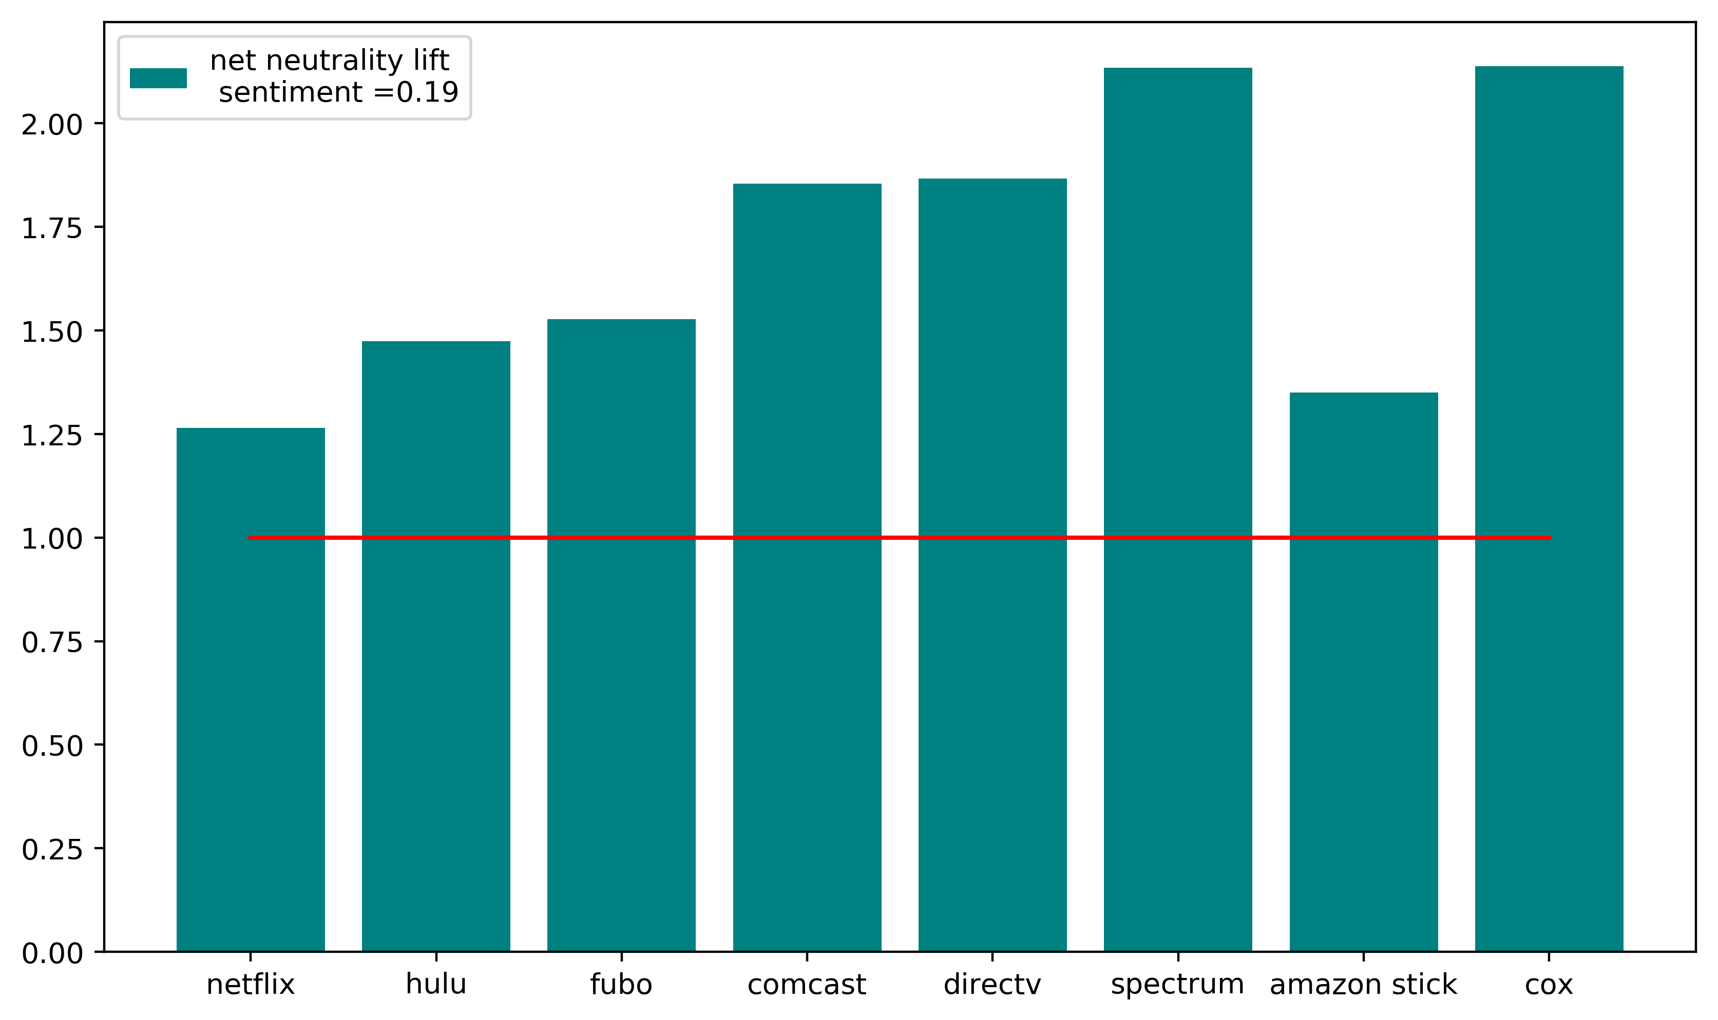
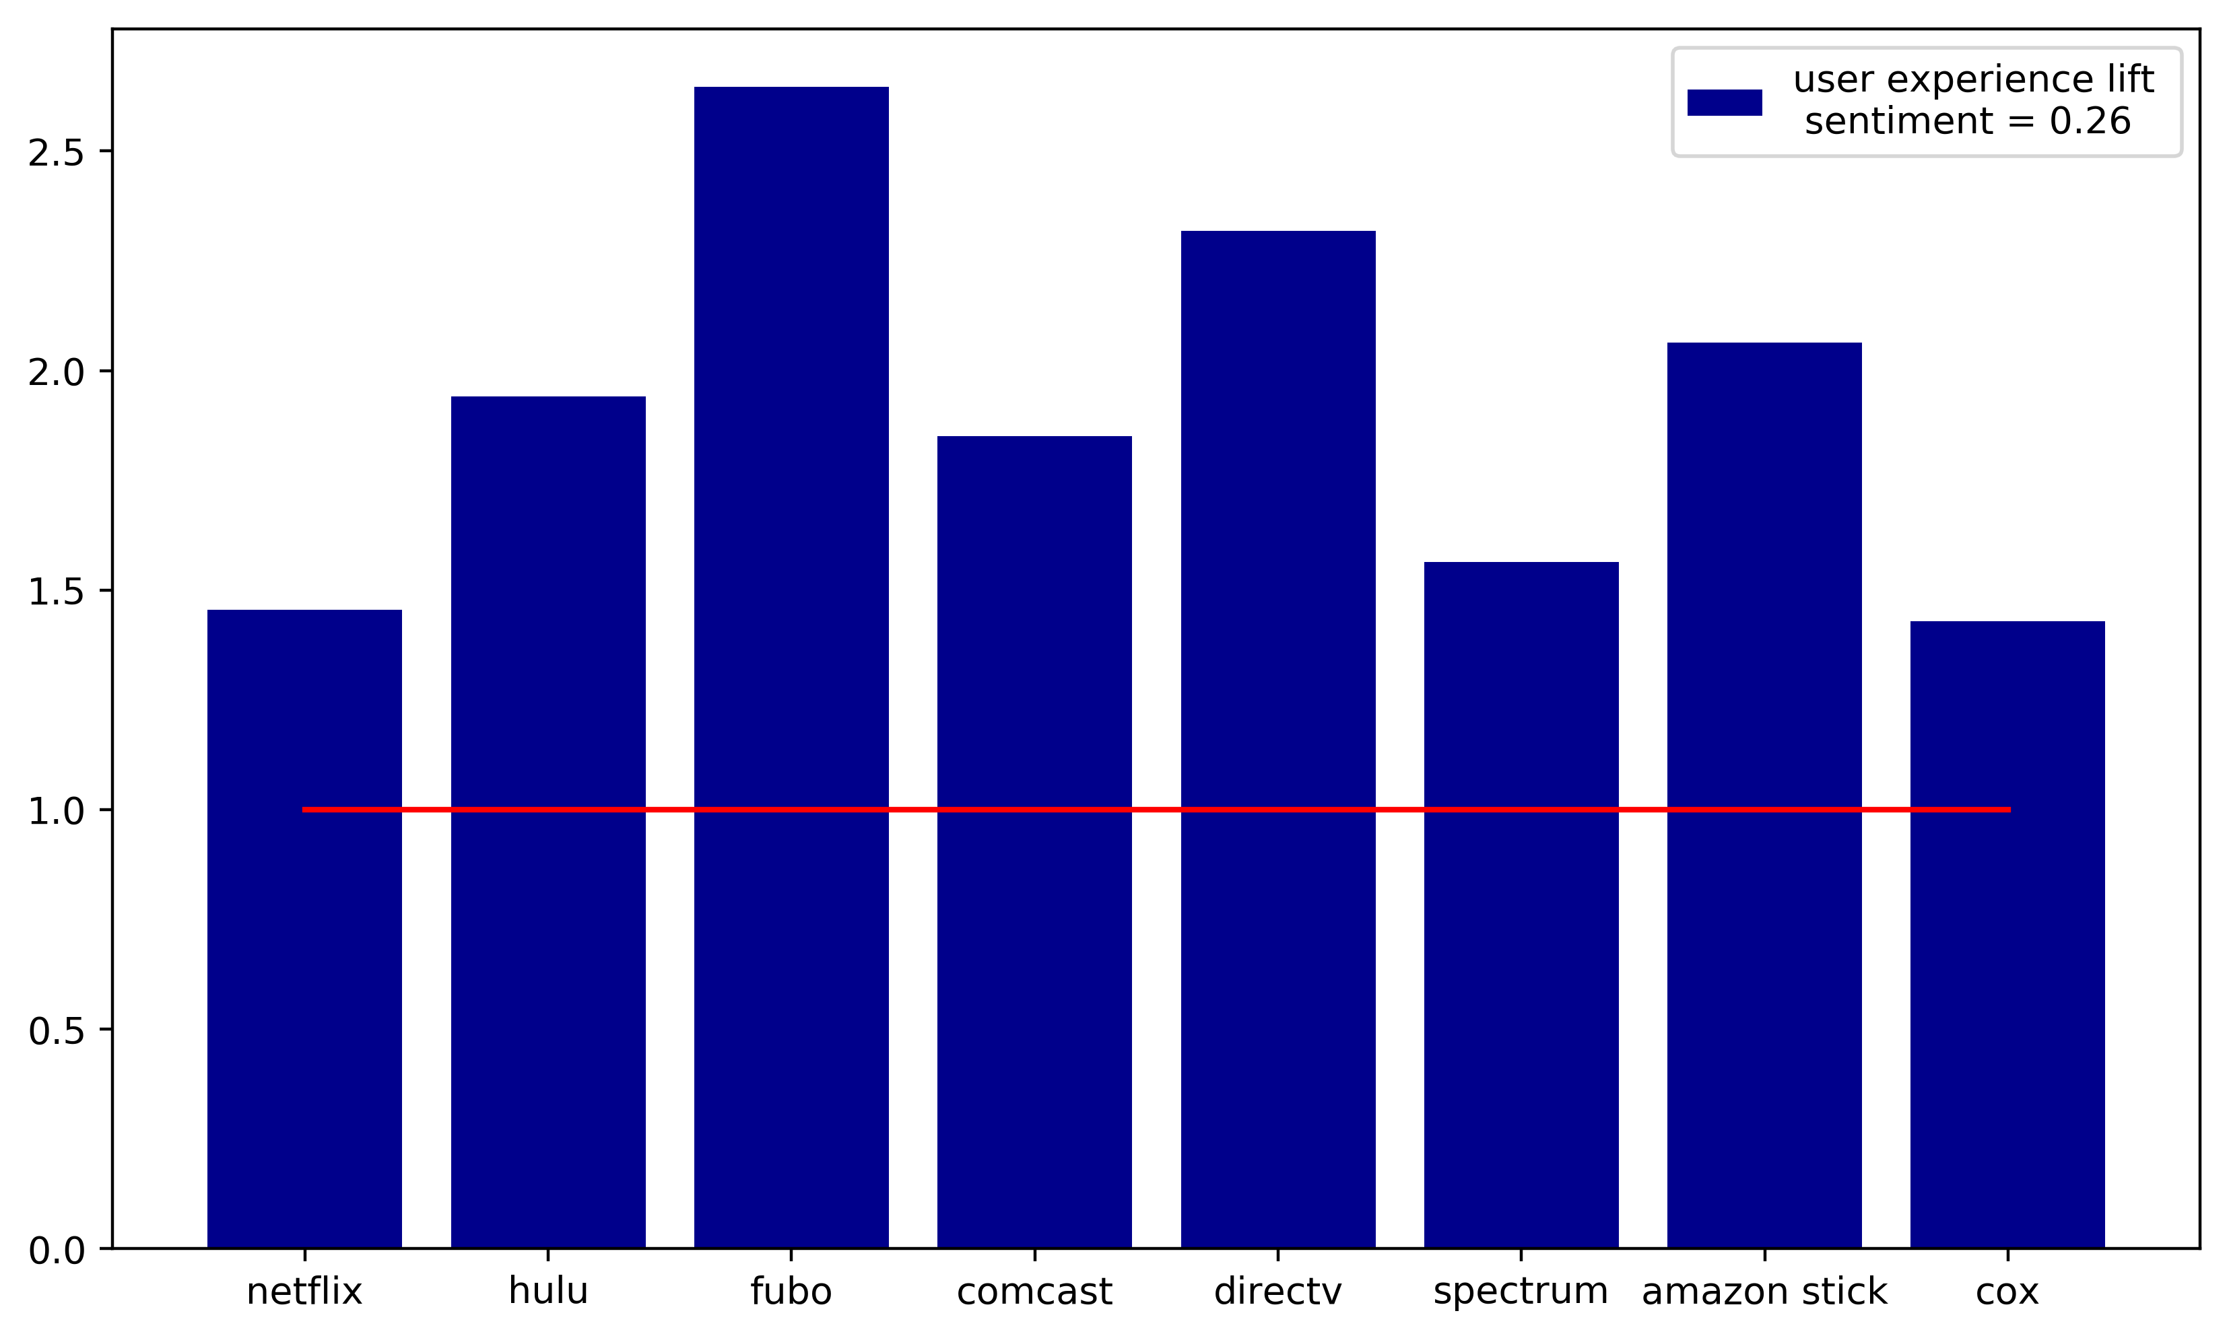
Topic Modeling – Lift Analysis
Traditional Cable
Sports Packages
Net Neutrality
User Experience

Slide 11

Let Bigrams be Bigrams
Original Programming
Free shipping
Annual subscription
Free Trial
Hidden Fees Total Cost
Sneaky Pete
Amazon Prime
Stranger Things
Original Content
Exclusive Content
Black Mirror
Their Catalog
My data
Adam Sandler
Netflix
Direct Tv Now
Best picture
Better DVR
NFL network
Great Price
Concurrent streams
Regional Sports
Local broadcast
Xfinity
Too Expensive Their streaming Slow Service
Good Reception
Hulu
Free Trial
Few bucks
Commercial Free
Not Skip
Their Originals
Big Bang Theory
FuboTV
Good Choice
Super Bowl
Red Zone
Expensive
Worst App
Bad Service
Notes:
Processing all of the comments and found the significant bigrams
With these bigrams, we found sentiment scores associated with each using VADER (sort bigrams by sentiment and show the first and last 5 as a picture on this slide)
We then found the lift between companies or service providers

Slide 12

The Best Bigram Ever…
Hulu
My Eyes!!
“Hulu’s UI makes me want to jab a spork into my eyes”
my eyes, my eyes!
Notes:
Processing all of the comments and found the significant bigrams
With these bigrams, we found sentiment scores associated with each using VADER (sort bigrams by sentiment and show the first and last 5 as a picture on this slide)
We then found the lift between companies or service providers

Slide 13
Conclusion
What are the tendencies of people who cut the cord?
We mined relevant entities from the comments
MDS Plotting shows divides between channels, services, and cable companies
What are the concerns of cord-cutters?
LDA shows important topics are sports packages, net neutrality, the traditional cable experience, and user experience
Niche products – FuboTV – are associated more with product related topics as opposed to general interest topics
How do cord-cutters view certain services?
Bigram analysis yields features of different streaming services
Sentiment analysis also shows crowd attitudes towards specific shows and actors (ex. Adam Sandler, Big Bang Theory, Stranger Things)
Notes:
Fubo, a niche product, has a relatively high frequency of words from product-related topics such as user experience and sports packages
Fubo also has a relatively low frequency of words from general concern topics, such as net neutrality and traditional cable experiences

